Slide 1

FINDING THE BEST POSSIBLE LOCATION FOR A NEW FLOWER SHOP

Slide 2
Problem and background
The problem I want to solve is to find the best possible location(s) to start a new flower shop in the city of Zurich, Switzerland
Location is a key success factor for both pillars of such a business, which are:
Selling flowers to customers visiting the shop
Delivering flowers, ordered either by internet or over phone
Finding the best location is thus very important for the future business owner
Also, it is important to be able to explain and demonstrate why a specific location is suitable, to convince potential investors and banks of the viability of the future business

Slide 3
Requirements for the shop’s location
The ideal location should have the following characteristics:
In a densely populated district of the city (we assume here that purchasing power and propensity to buy flowers is similar in each district, so that only the population density matters).
Near high-traffic public transportation hubs. Zurich mostly relies on a tram system, so that means the shop should be located near the tram stops with the highest number of daily passengers.
In a quite central area of the city, so that most of the city is a quickly reachable for deliveries. A location at the periphery would severely restrict the delivery business’ potential.
At least 1’000 meters away from the next flower shop. Being closer from established competition would make it difficult to establish a new business. On the other hand, finding a ‘white space’ away from any competitor may help a lot.
Ideally - but only if all other criteria are met - the shop should be in a pedestrian area, as (i) passerby are more relaxed and more inclined to shop flowers in pedestrian areas and (ii) this brings nicer working conditions for the shop’s employees.

Slide 4
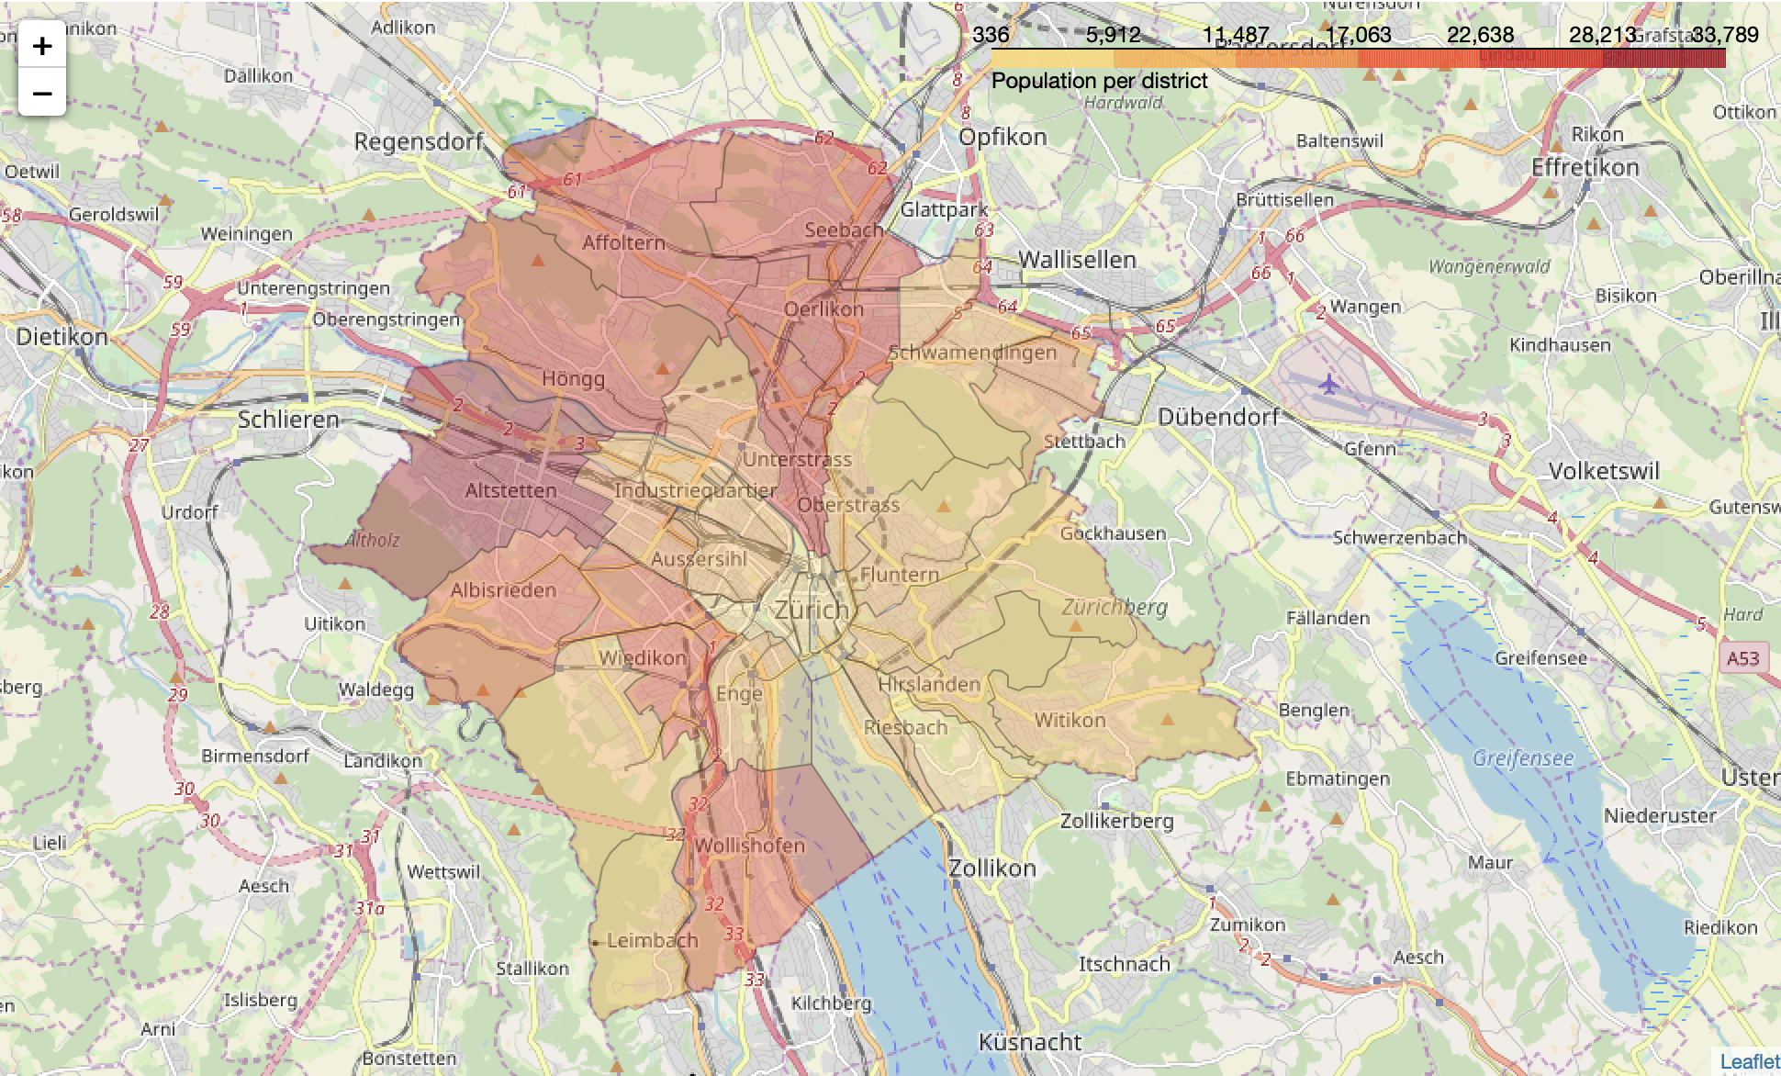
The densely populated districts are mostly close to the city periphery, while the historic center is less residential

Slide 5
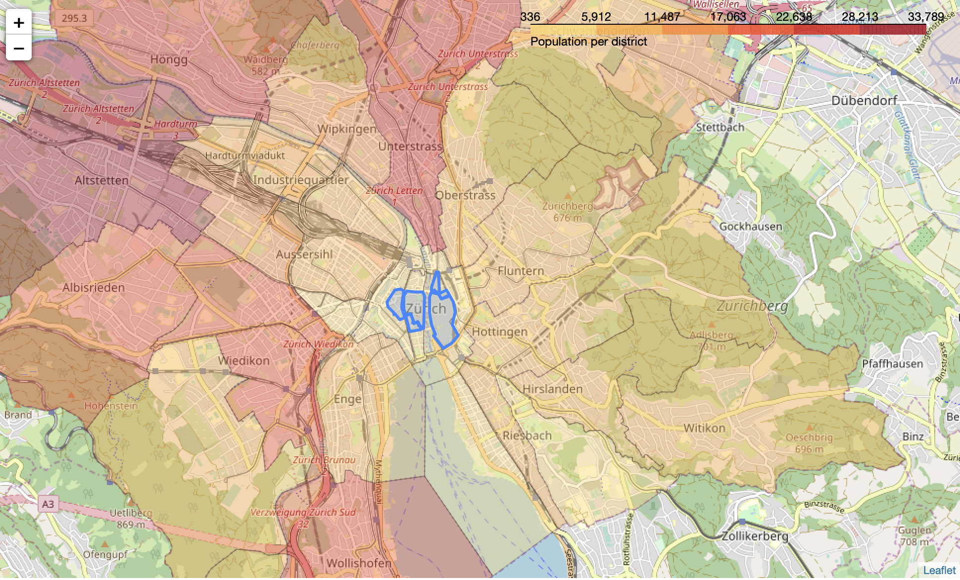
The pedestrians areas are quite small, and concentrated in the heart of the historic center

Slide 6
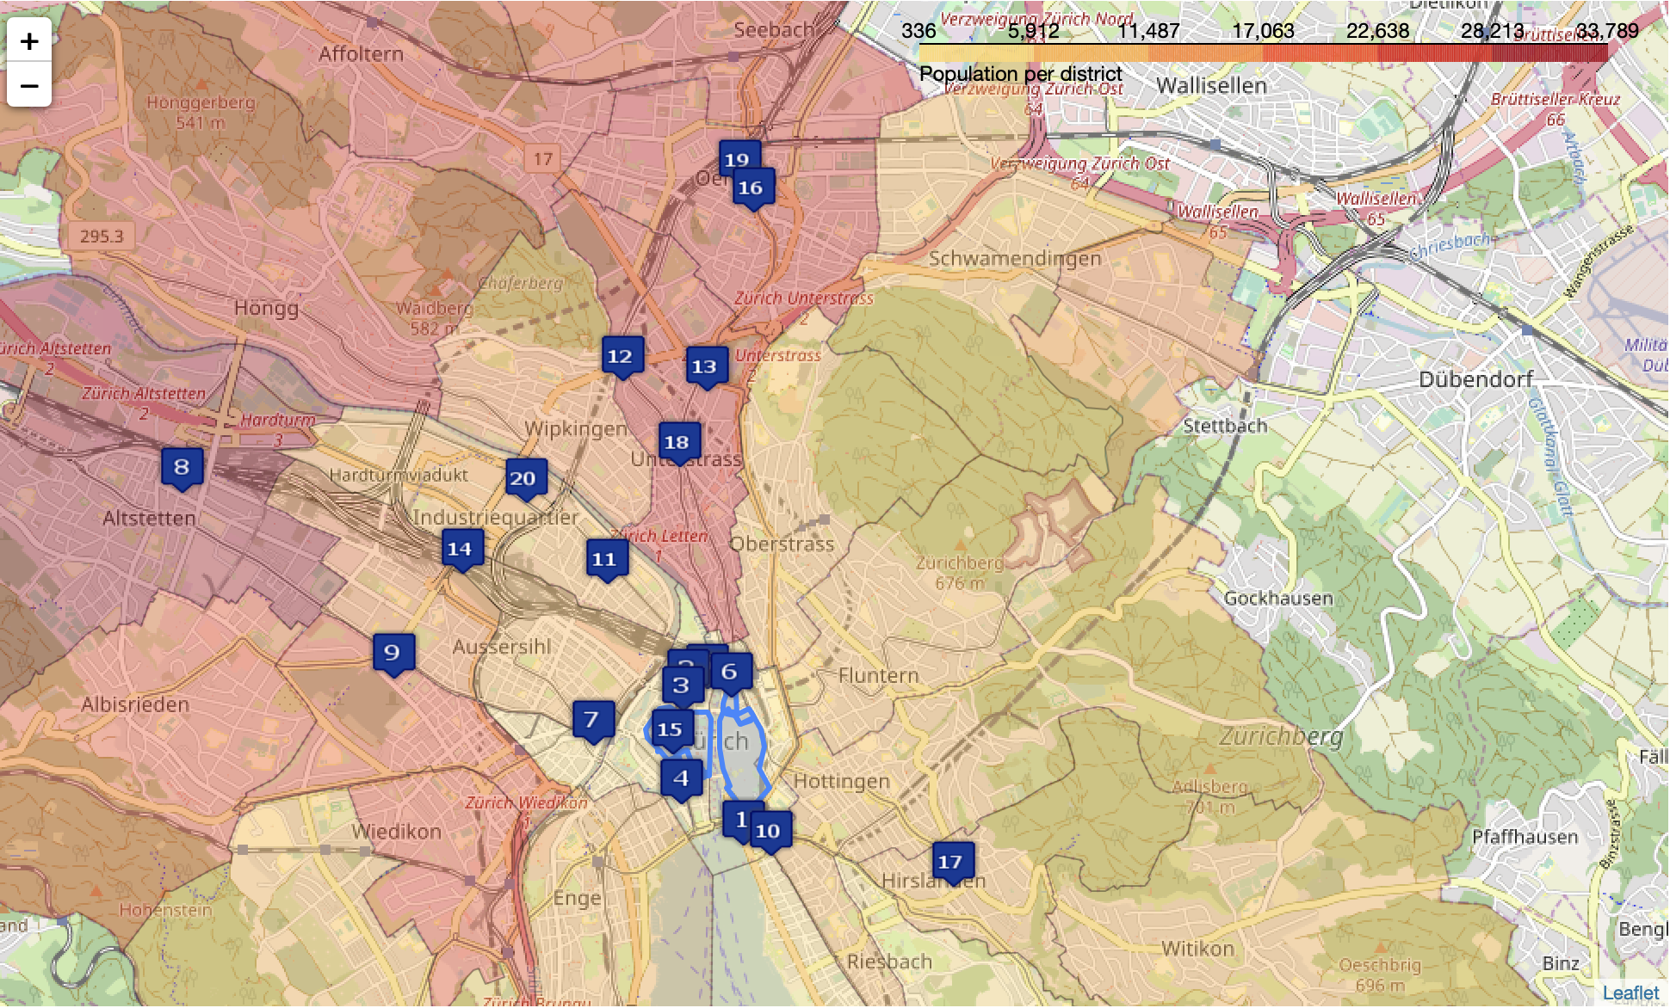
Most of the top 20 tram stations are (i) in the city center or (ii) on a SW/NE axis orthogonal to the train tracks

Slide 7
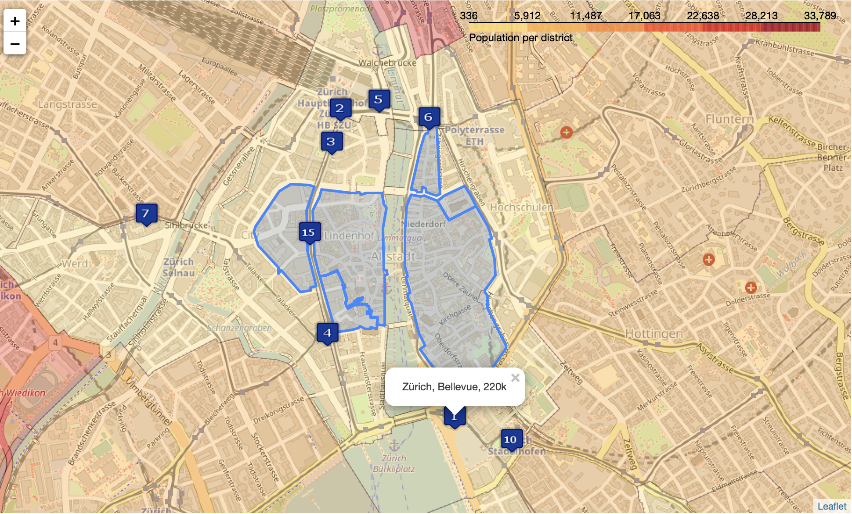
8 of the top 10 tram stations are in the city center; Bellevue is the busiest, with 220k passengers per day

Slide 8
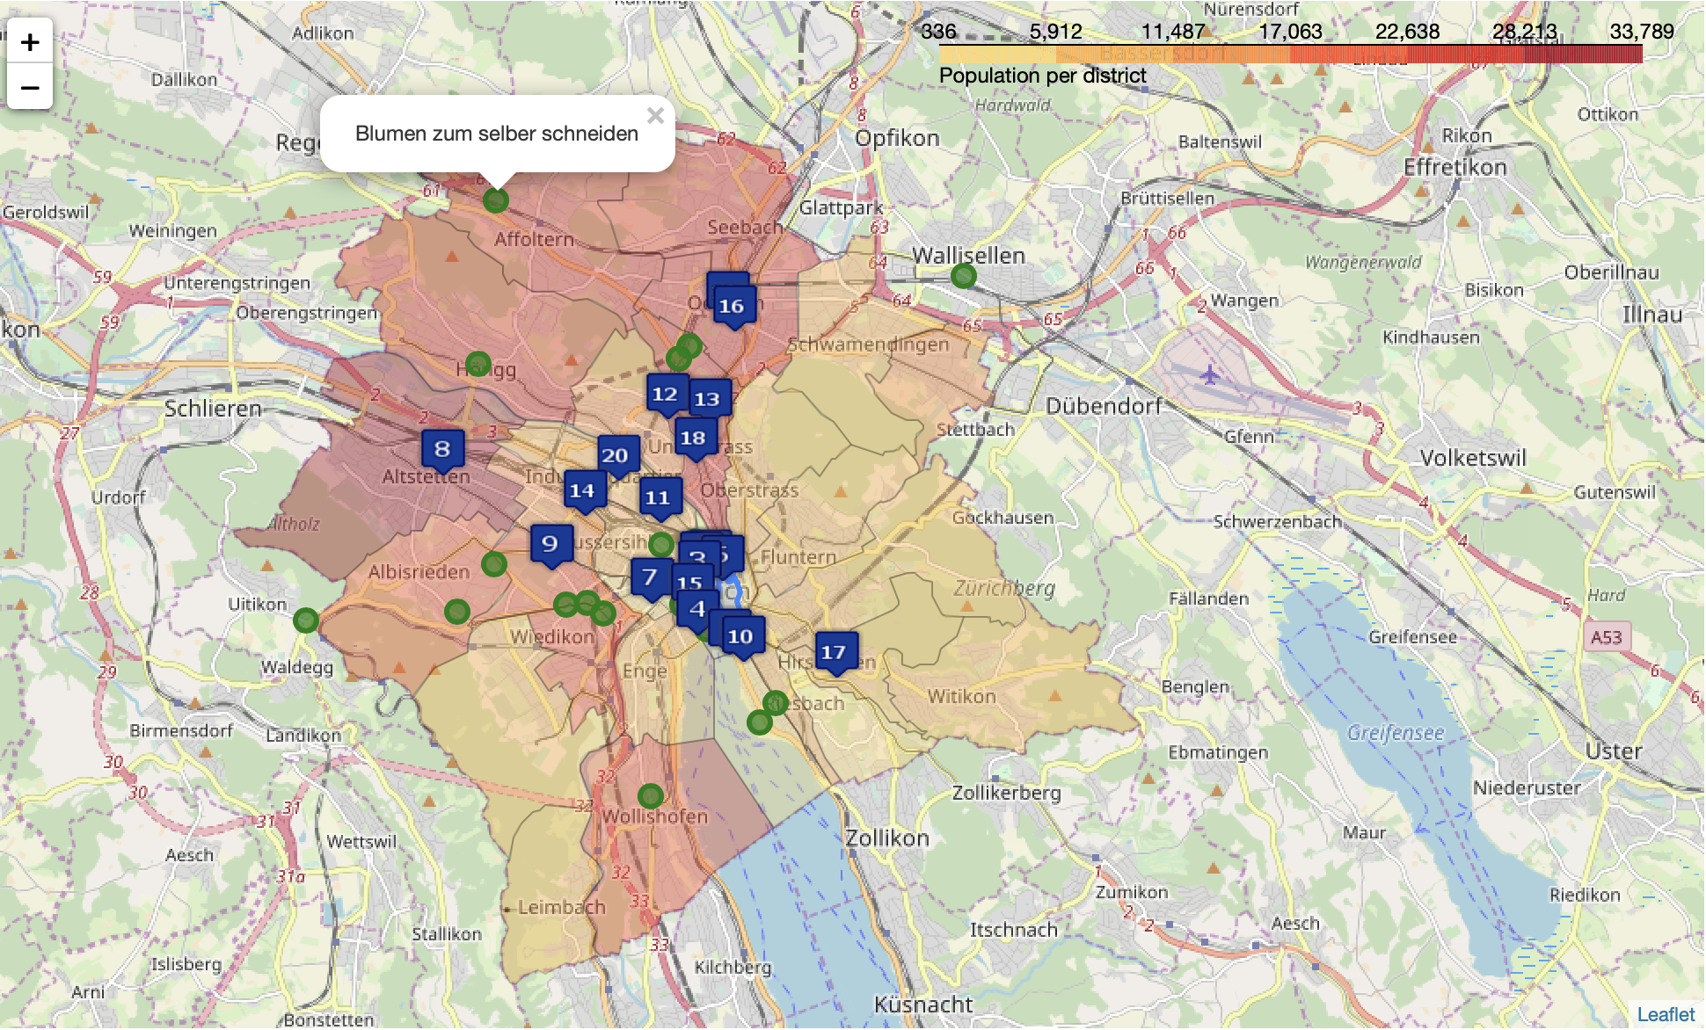
Adding the existing flower shops on the map will help us find a white spot for our future shop

Slide 9
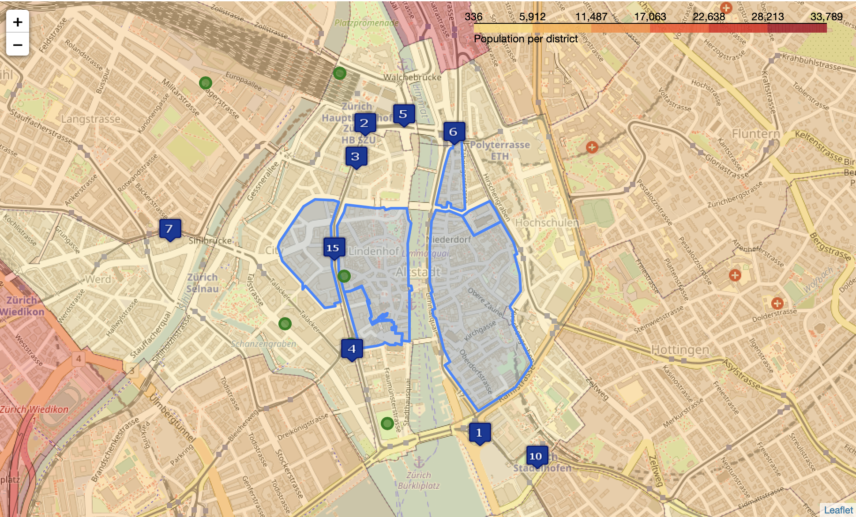
Unfortunately, there are already 5 well established flower shops in the city center, close to the top tram stations…

Slide 10
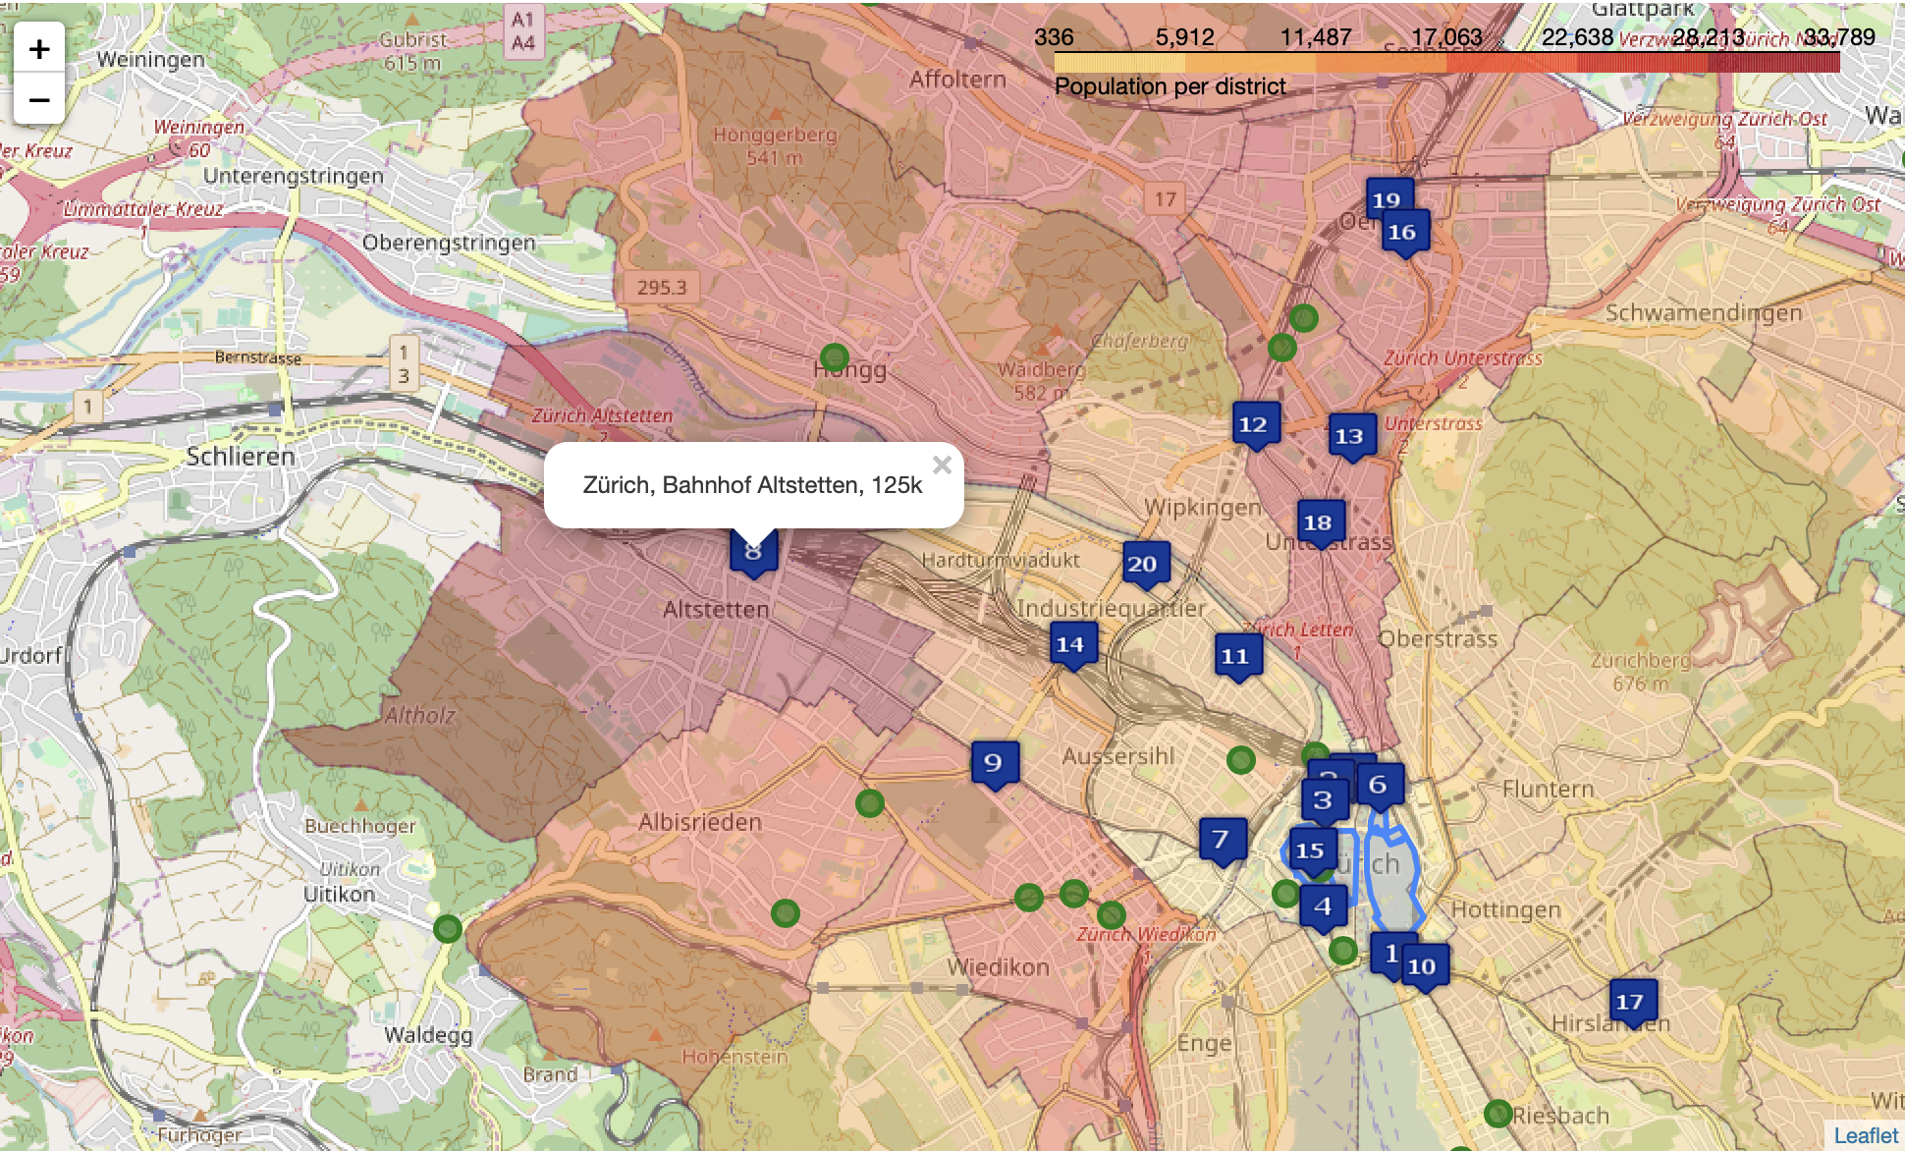
…however Alstetten station seems to offer the most promising white spot
8th most busy station, 125’000 passengers per day
In the middle of one of the most populated districts of the city
Still quite central for deliveries
1) As per Foursquare dataset

Slide 11
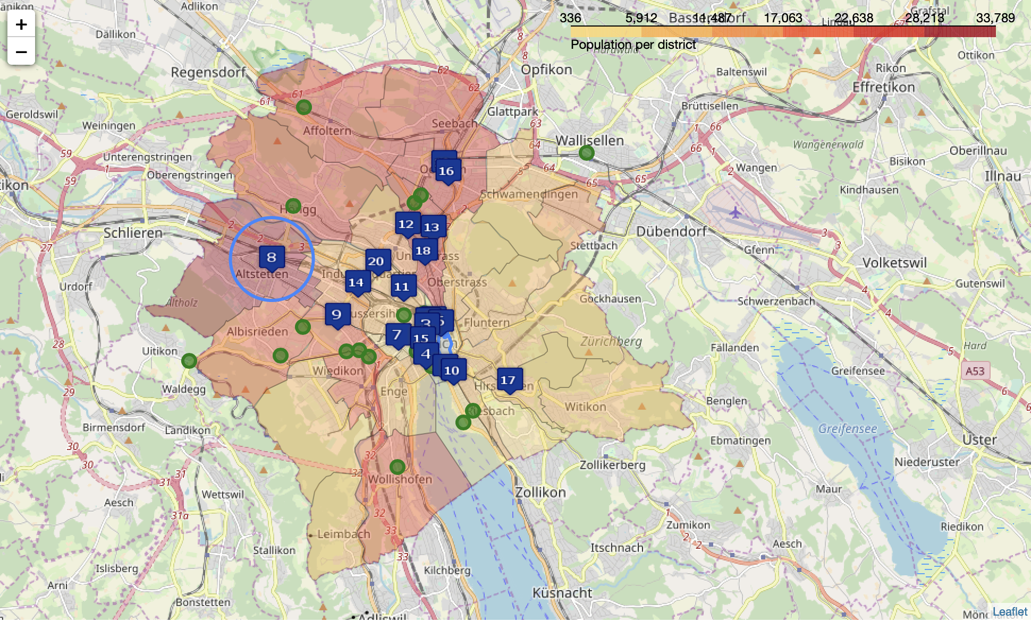
Fortunately, there is no established competitor with 1’000 meters

Slide 12
Conclusion and future direction
Going through the location criteria we defined at the beginning, we were able to zoom in on very promising white spot for our future flower shop
This was made possible by the data available from three sources:
The folium library
The Open Data catalogue of Zurich City (https://data.stadt-zuerich.ch, in German)
Foursquare.com
Altstetten station seems the most promising location for our future shop . It meets most our criteria, although it is unfortunately not in a pedestrian area
It is not guaranteed however that we will find a suitable space to rent near Altstetten within our desired timeframe. If such is the case, we will simply iterate on our search, and look for the second best option. On the other hand, one of the established competitors may come up for sale in the near future (for example if the owner retires), so we need to keep an eye on those
Moving forward, we could improve the analysis if additional data was available:
Income per capita for the different city districts
Turnover statistics from the existing competitors..

